Slide 1
MATH TECH MARVELS PPT
TEAM
1.CLARINA XAVIER
2.VEDULA VENKATA ADITHYA
3.ROSHNI PRABHU

Slide 2
INDEX
Some Basic Stock Terms
History and works of Louis Bachelier
Black–Scholes model

Slide 3
INDEX
Prediction using Black–Scholes model
Disadvantages of
Black–Scholes model
*BONUS:Some alternative prediction methods

Slide 4
1. Some Basic Stock Terms
Without diving into the jargon of theoretical definitions and so on,let us understand stock options , whose thorough understanding is required to appreciate the beauty of Bachelier and scholes work.
We shall understand the most complex of terms with a very simple yet effective example

Slide 5
There are 2 friends Alice and Bob
Alice owns a piece of land worth 100,000 USD which she wants to sell.
Bob who feels a highway project may undergo construction in the coming 3 months,is interested in this piece of land,as after the upcoming of the highway,
The value of the land will tend to shoot up.(its location becomes more “attractive”).Bob is interested in buying.
But,Bob does not know for sure whether the project will occur or not,so there involves a risk when he outright buys the land.
Bob comes up with an idea,he talks to his friend Alice saying;
“3 months later,I would like to buy this land for the same price of 100,000USD” no matter what the market price is,but if im not interested in the purchase then,then i wont buy”

Slide 6
Alice thought about this for a while,but declined.From her perspective she is holding out a piece of land she wants to sell for 3 WHOLE MONTHS without any benefit for her favour.So,if she levies a small fee over him,its beneficial for her.
Reason why bob pays the fee:He gets the option to buy/not buy this land.
Alice suggests an agreement and They both finally come into an agreement;
“I,Bob may/may not buy the piece of land Alice owns in the coming 3months at the price of 100,000 USD for a small fee of 200USD”
Now,observe carefully,
Bob has a right but does not have an obligation to buy the piece of land at a fixed price of 100,000 USD for a small premium of 200USD
This is a buy option , commonly refferred to as a “CALL OPTION”

Slide 7
Commonly used terms:
200 USD FEE -> Premium , Alice -> Call option seller , 3 months -> Expiration
100,000 USD -> strike price , Bob -> Call option buyer period
We have now understood the meaning of a Call option,its definition is as follows:
Call option: The right to buy at a later date for the strike price.
The right but not the obligation to buy something at a later date for a pre-specified price (the strike price)

Slide 8
Now,Sell option is the exact opposite of Buy option
Sell option -> commonly referred to as Put option
Put option:The right to sell something at a later date for the strike price.
The right but not the obligation to sell something at a later date for a pre-specified price (the strike price).
I hope with this example,you have understood the many jargons related to the Options world,keeping a strong fundamental base will help vastly in the upcoming topics
This understanding with Land is same for the stock market as well

Slide 9
2.History and work of Louis Bachelier
Louis Jean-Baptiste Alphonse Bachelier (French: [baʃəlje]; 11 March 1870 – 28 April 1946)[1] was a French mathematician at the turn of the 20th century. He is credited with being the first person to model the stochastic process now called Brownian motion, as part of his doctoral thesis The Theory of Speculation (Théorie de la spéculation, defended in 1900).
Bachelier's doctoral thesis, which introduced the first mathematical model of Brownian motion and its use for valuing stock options, was the first paper to use advanced mathematics in the study of finance. His Bachelier model has been influential in the development of other widely used models, including the Black-Scholes model.
Bachelier is considered as the forefather of mathematical finance and a pioneer in the study of stochastic processes

Slide 10
Louis’s model functioned in such a way that at any given instant of time,the probability of price going up was equal to the probability of price going up = 1/2.He believed neither the buyers,nor the sellers should get an advantage.
So he priced stock options in the way such that probability of making money = losing money (over a large number of observations)
He believed in this model because more the people trying the predict the stock/market index , lesser predicable it becomes.
He observed over a bell curve when the probabilitiy of making money was graphed,simpler way to understand this is using a galter board(idk sepling)

Slide 11
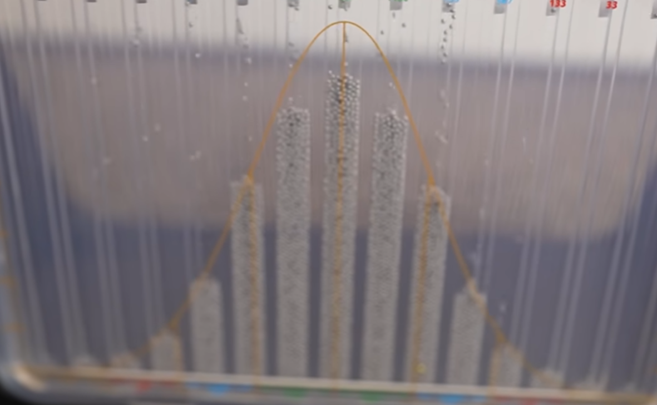

Slide 12
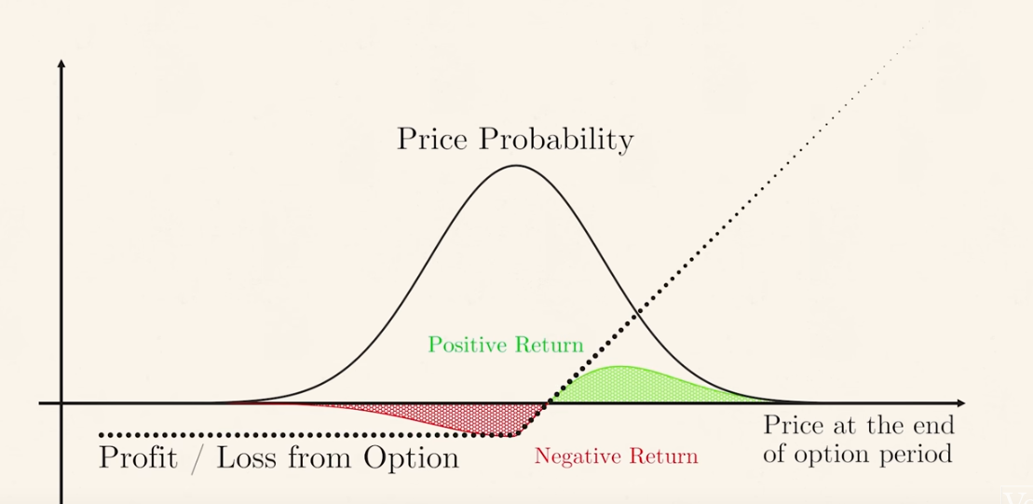

Slide 13
4. Black SCHOLES equation
The Black-Scholes model, developed by Fischer Black, Myron Scholes, and Robert Merton in the early 1970s, Bachelier's work laid down some foundational concepts for understanding the behavior of financial markets, particularly regarding the stochastic nature of asset prices.
From the perspective of the creators of the Black-Scholes model, their key insight was to build upon Bachelier's ideas and develop a more formal and practical framework for valuing options. They recognized that options pricing could be approached using principles from stochastic calculus and arbitrage arguments. The model they developed revolutionized the understanding and practice of options pricing.

Slide 14
The Black-Scholes equation provides a theoretical framework for calculating the fair market value of European-style options, assuming certain idealized conditions. It's important to note that while the Black-Scholes model is widely used and has been highly influential in the field of finance, it does have its limitations and may not always perfectly reflect real-world market conditions.
The Black-Scholes equation considers factors such as the current stock price, the option's strike price, the time until expiration, the risk-free interest rate, and the volatility of the underlying stock. By inputting these variables into the equation, one can calculate the theoretical price of a European call or put option.

Slide 15
Derivation of black scholes:
The derivation is very lengthy and involves partial differentiation ,
Im Just introducing it here
V = f(S , t)
V is the value of stock option , it is a function of time at present and the strike price.
If you’re interested in the derivation;
https://github.com/Adithya-Vedula/MATHTECHMARVELS

Slide 16
Imagine you're playing a game where you can buy or sell toys, and the price of each toy can change randomly over time. Let's say you have a special toy, and you're thinking about selling the right to buy it from you at a certain price in the future. That's like selling an option.
Now, to figure out how much that option might be worth, we need a way to predict what the price of the toy will be in the future. That's where the Black-Scholes model comes in.
Current Price of the Toy: This is the price of the toy right now, let's call it SS. It's like looking at how much the toy costs at this moment.
Time to Option Expiry: This is how much time is left before the option expires, let's call it TT. If you have more time before you can buy the toy, the option might be worth more because there's a chance the toy's price could change a lot before then.

Slide 17
Volatility of the Toy's Price: Volatility is a measure of how much the price of the toy changes over time. If the price of the toy goes up and down a lot, it's more volatile. We use a symbol called σσ to represent this volatility in the formula.
Interest Rate: This is like the return you could get if you put your money in the bank instead of buying the option. We use rr to represent the interest rate.

Slide 18
Now, the Black-Scholes formula looks like this for a call option (the right to buy the toy):
C=S⋅N(d1)−X⋅e−rT⋅N(d2)C=S⋅N(d1​)−X⋅e−rT⋅N(d2​)
And like this for a put option (the right to sell the toy):
P=X⋅e−rT⋅N(−d2)−S⋅N(−d1)P=X⋅e−rT⋅N(−d2​)−S⋅N(−d1​)

Slide 19
C and P are the prices of the call and put options, respectively.
X is the strike price, which is the price you've agreed to buy or sell the toy for in the future.
e is a mathematical constant approximately equal to 2.71828.
N(d) is a mathematical function that gives the probability that a random variable is less than or equal to d.
d1 and d2 are calculated using the following formulas:
d1=ln⁡(SX)+(r+σ22)TσTd1​=σT
​ln(XS​)+(r+2σ2​)T​
d2=d1−σTd2​=d1​−σT

Slide 20
To get a feel of it,
Black scholes provides us the predicted price of an option.
This is very useful , the next section is a simple way to make profitable trades using the black scholes equation.

Slide 21
4.Prediction using black scholes
Now were ready to see application of black scholes
VERY VERY SIMPLE LOGIC
Let A be the actual price of the option
Let B be the predicted black schloes price
2 CASES are now possible.

Slide 22
CASE-1: A > B [ACTUAL PRICE IS GREATER THAN BLACK SCHLOES PRICE]
Now if actual price of option is greater than the predicted price(that is black schloes price),it means in some period of time,the actual price tends to black schloes price and will fall.
So we can buy a PUT OPTION,allowing us to make money when the market is falling.
CASE-2: A < B [ACTUAL PRICE IS LESS THAN BLACK SCHLOES]
Now if actual price of option is less than the predicted price(that is black schloes price),it means in some period of time,the actual price tends to blac schloes price and will rise.
So we can buy a CALL OPTION,allowing us to make money when the market is growing.

Slide 23
For your convenience,i have made a python script which does the calculations for you.You can download it from below link:
https://github.com/Adithya-Vedula/MATHTECHMARVELS/

Slide 24
5. Disadvantages of Black–Scholes model
No Dividends: The original Black-Scholes model does not incorporate dividends paid by the underlying asset during the life of the option. In reality, dividends affect option prices, especially for options on dividend-paying stocks. Several adjustments have been proposed to account for dividends, but they add complexity to the model.
Assumption of Log-Normality: The Black-Scholes model assumes that the distribution of stock returns is log-normally distributed. While this assumption holds for some assets, it may not accurately capture the distribution of returns for all assets, especially during extreme market conditions.

Slide 25
6.*BONUS:Some alternative prediction methods
If options isn’t your primary interest,you can use RSI strategy in normal markets.
Explaining it is beyond the scope of this project.
However,i have made a script for it :)
Link to script:https://github.com/Adithya-Vedula/MATHTECHMARVELS/

